Slide 1
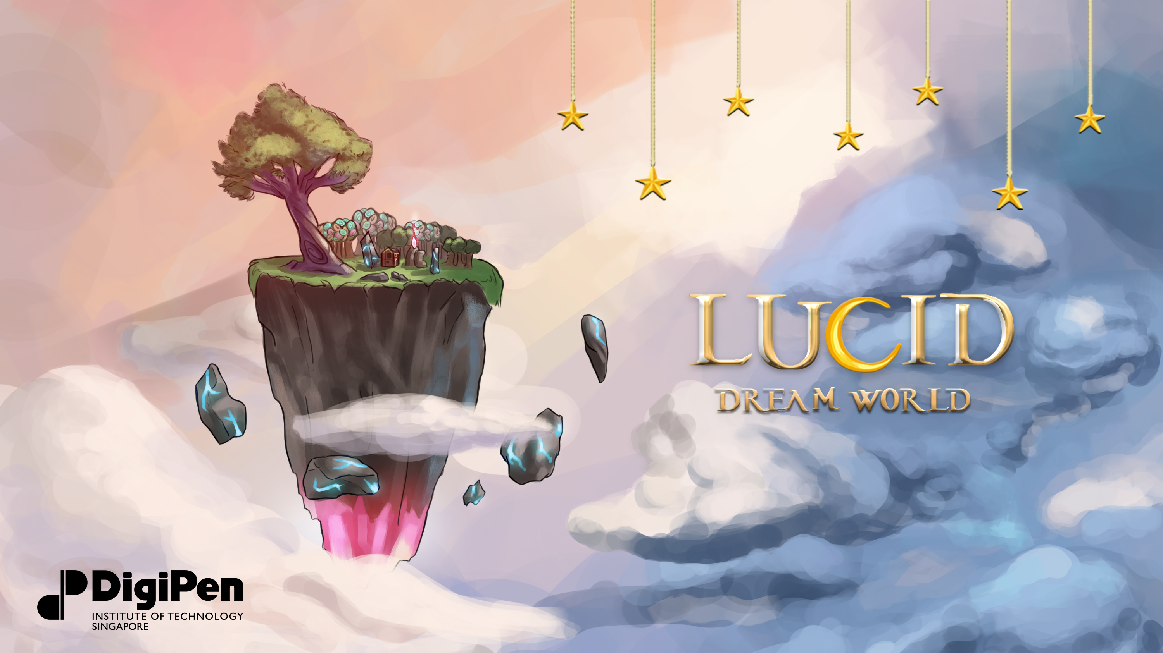

Slide 2
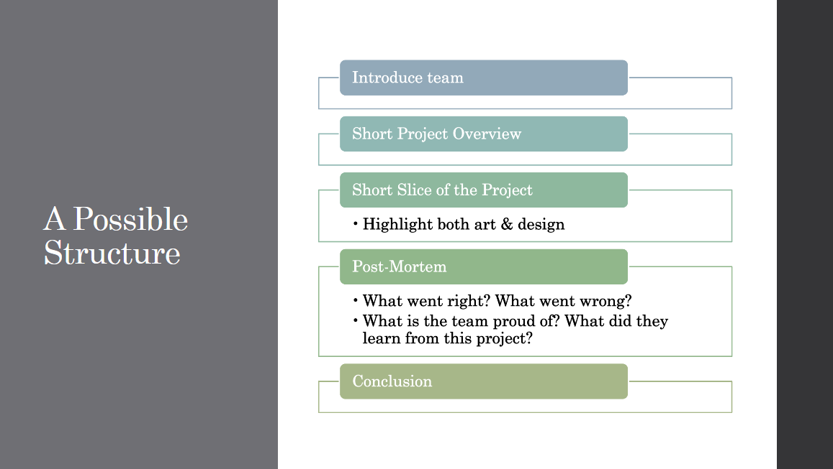

Slide 3
The Team
Darence
Dylan
Germaine
Joel
Venetia

Slide 4
Project Overview
Gamification of sleep therapy
Inspired by modern clicker games
Create and manage your sleep world
Main progression through sleeping

Slide 5
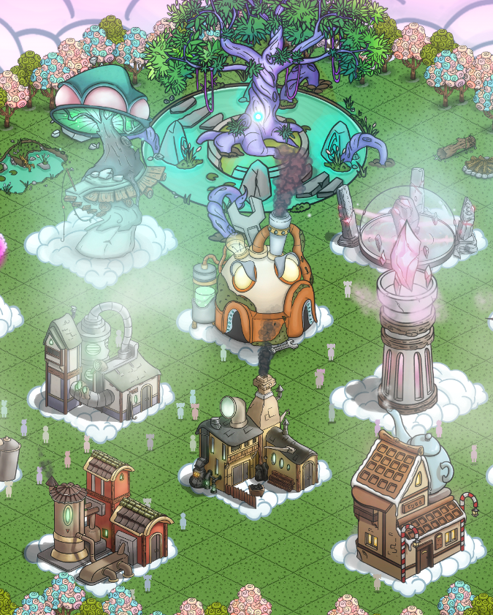
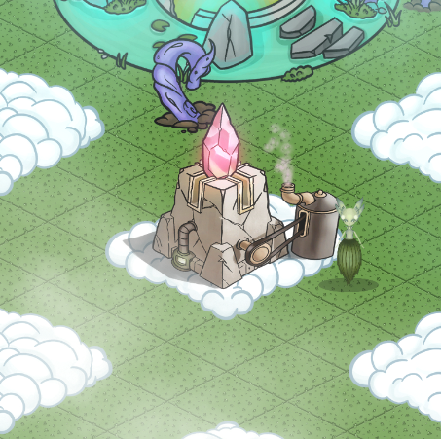
Project Demo
Starting out
Higher Level Game State

Slide 6
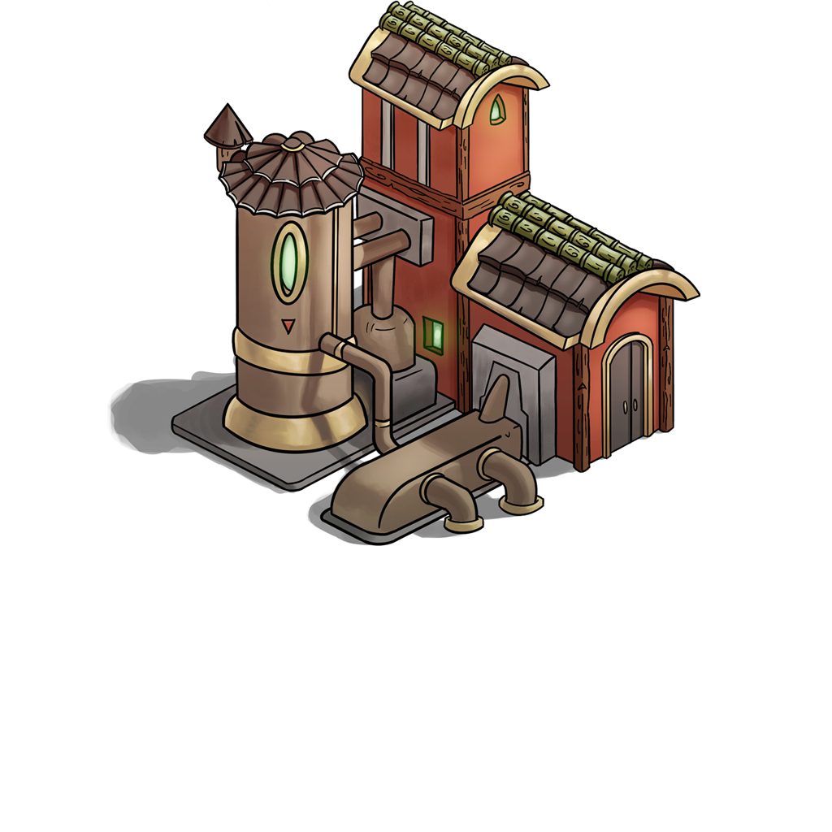
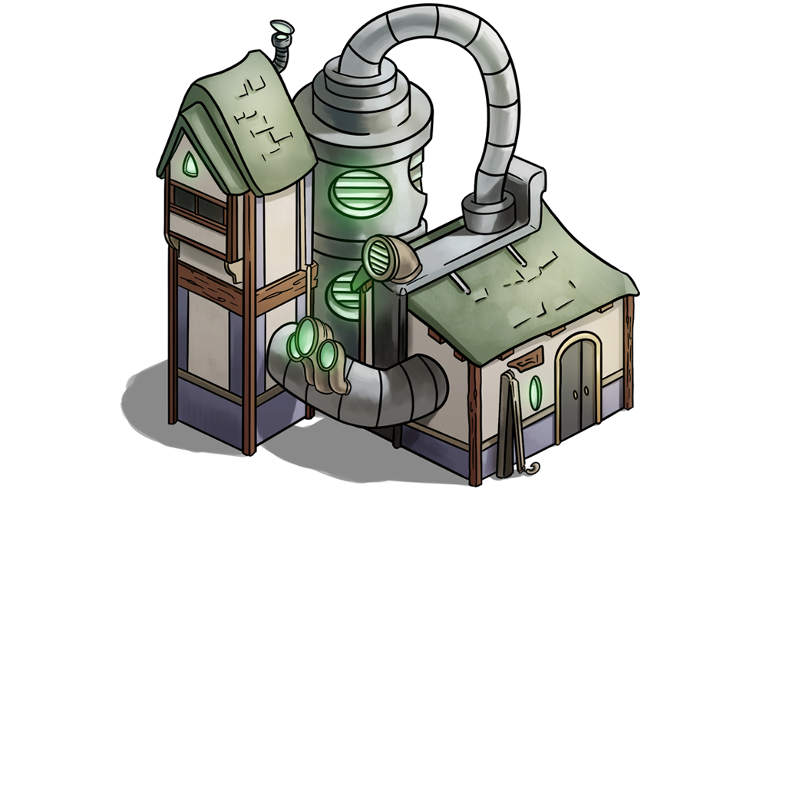
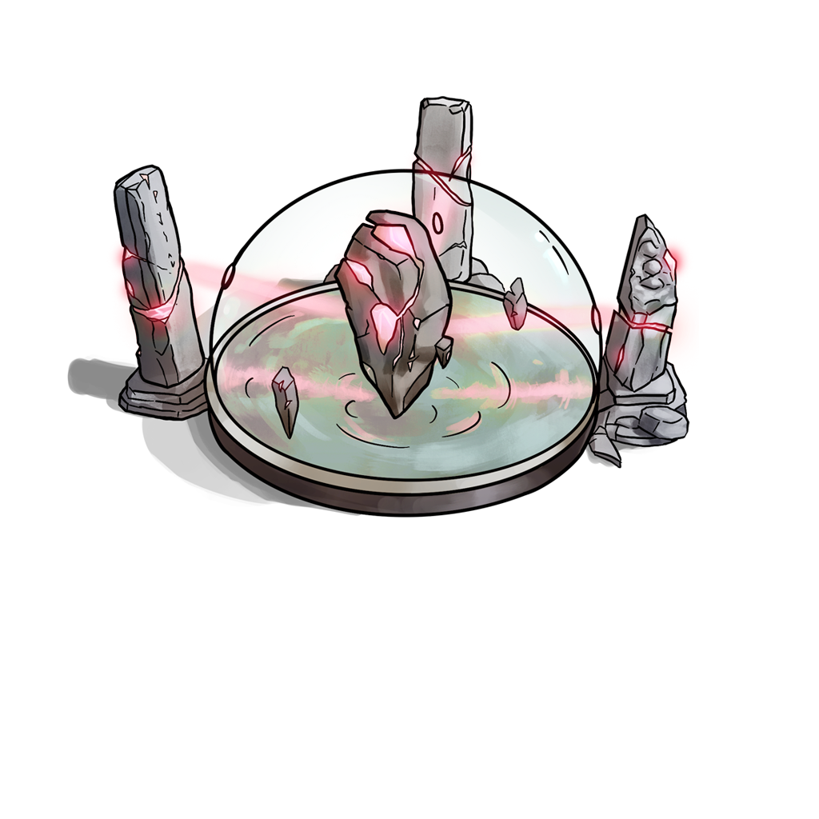

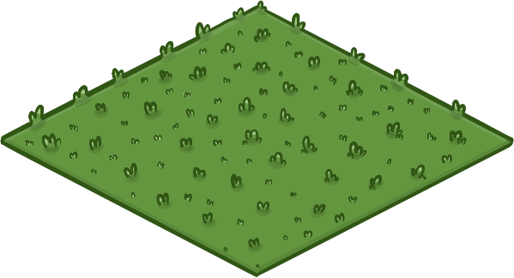
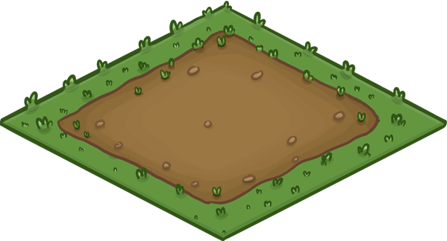
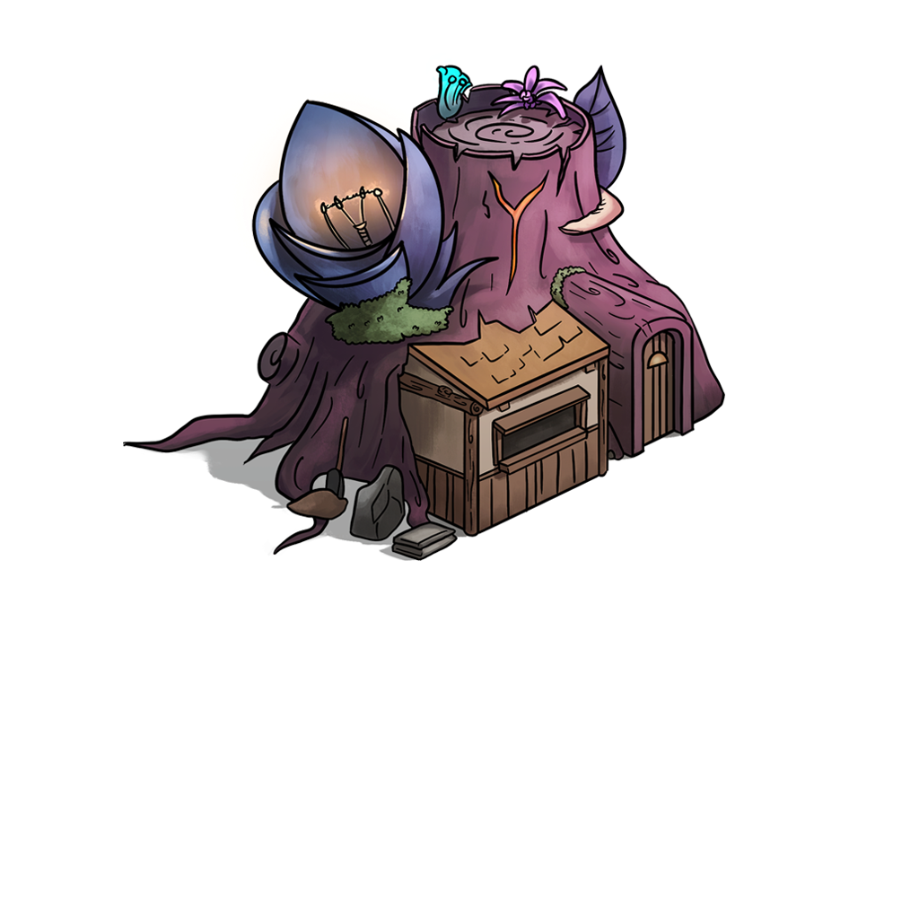
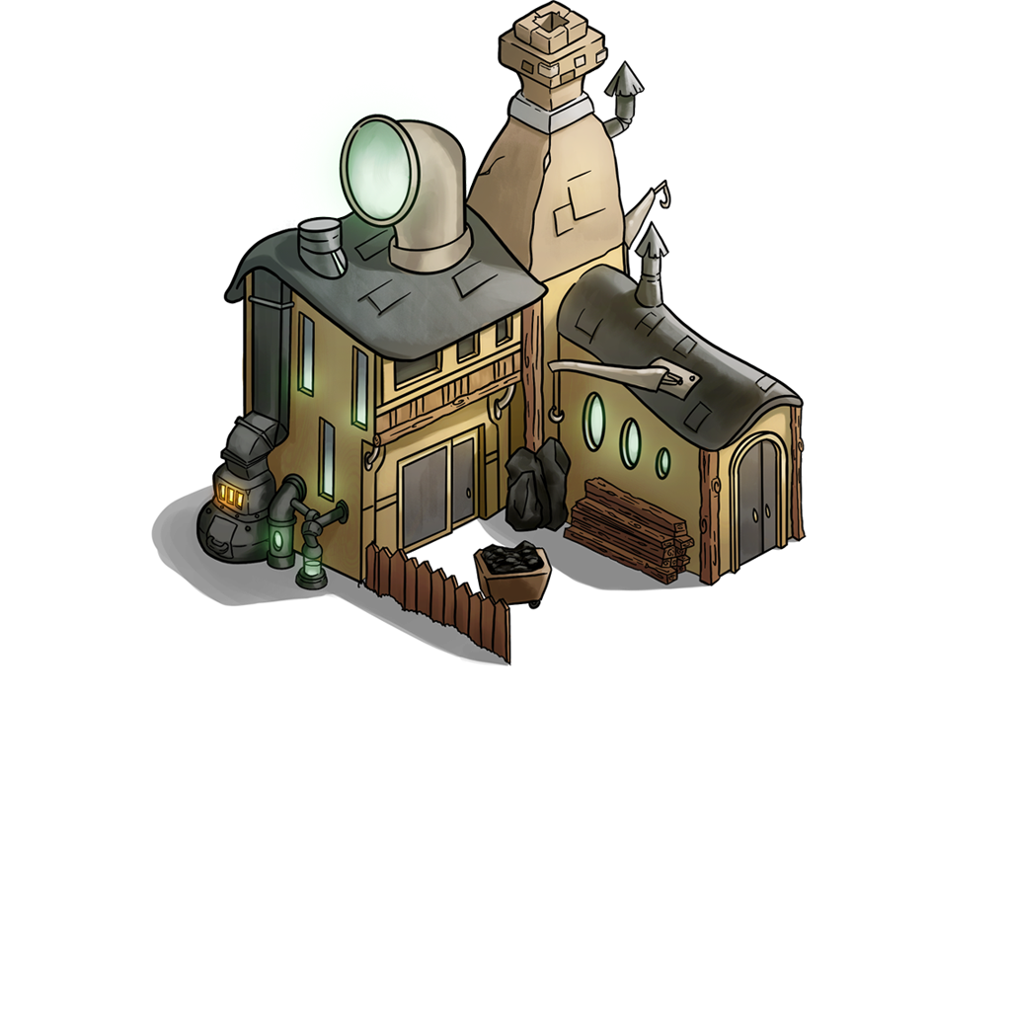
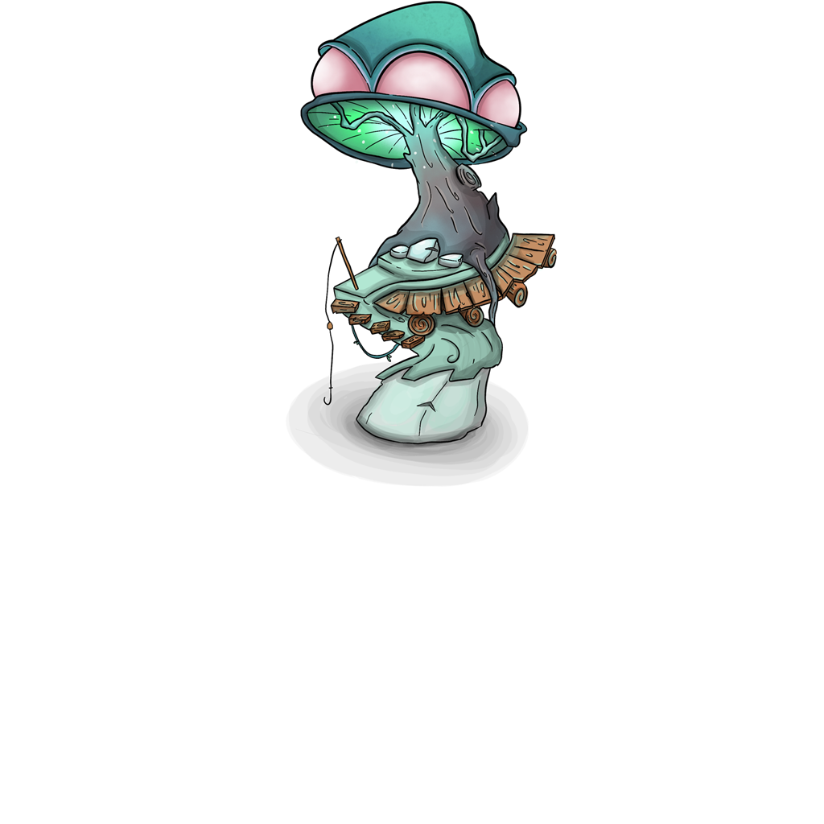
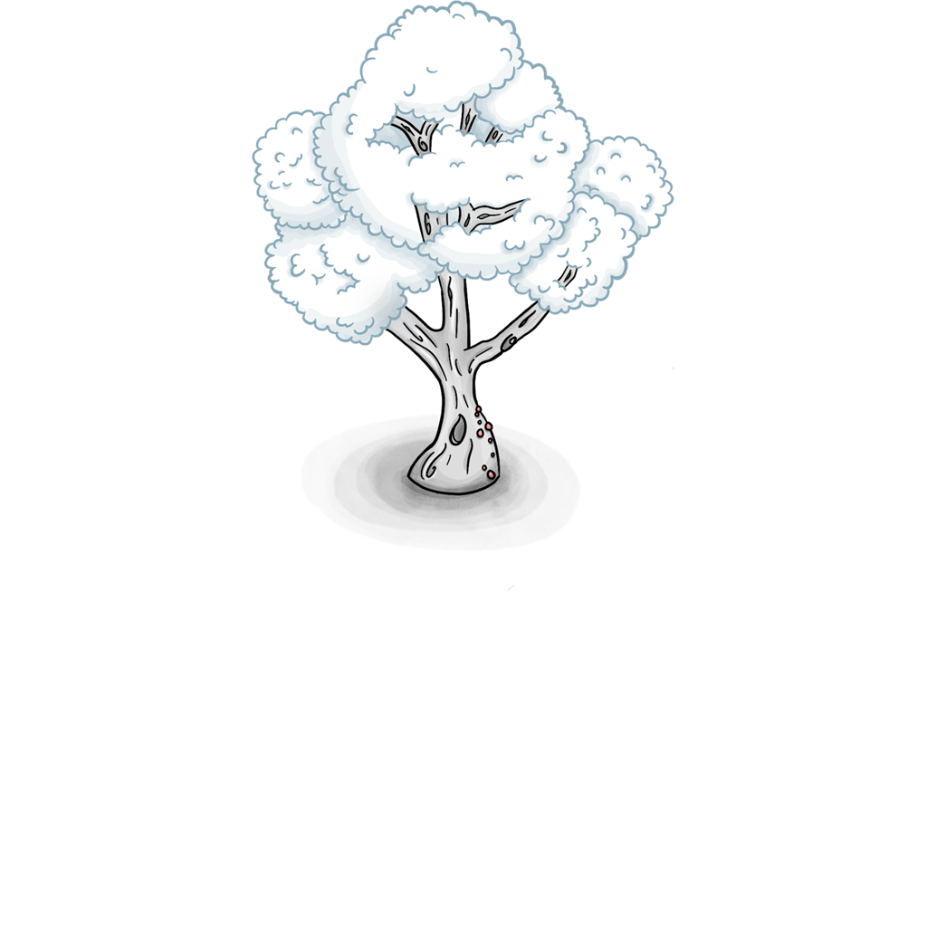
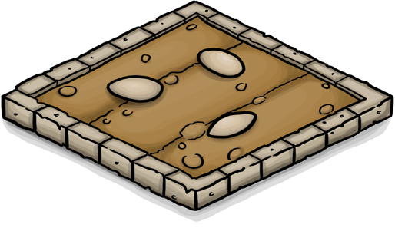
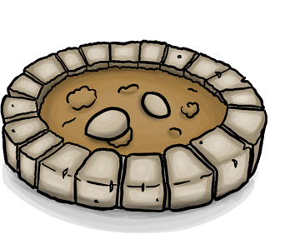
Environment Art

Slide 7
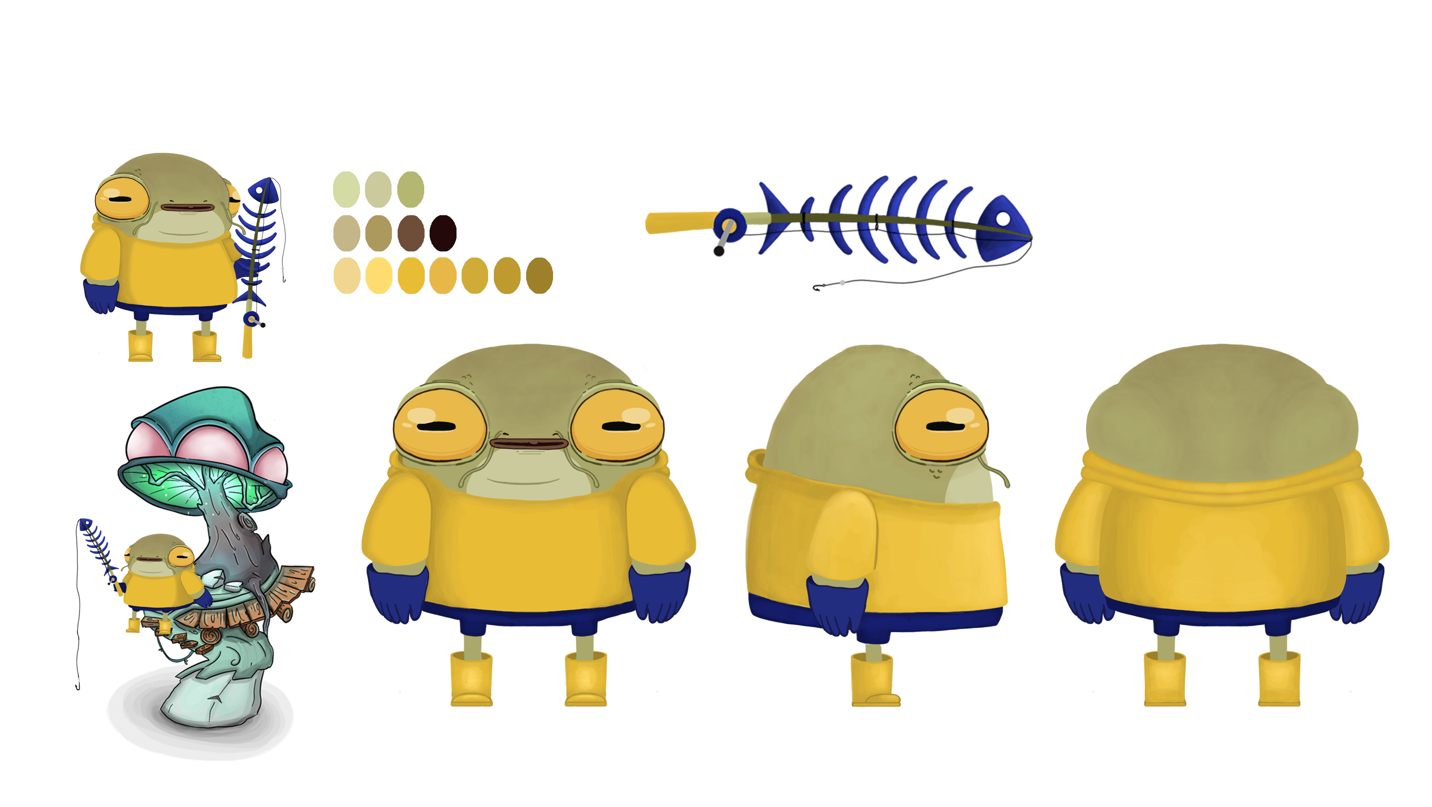
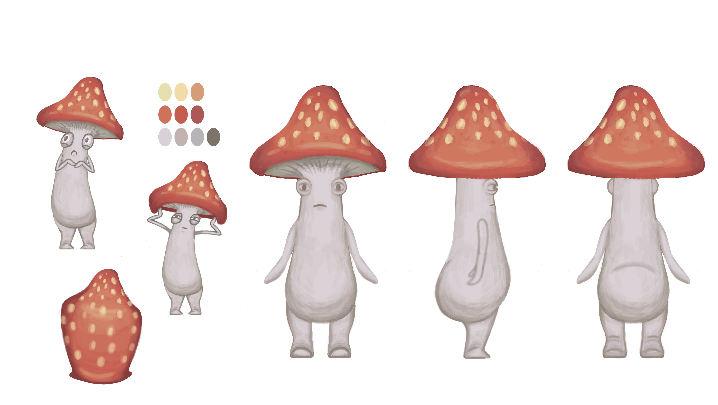
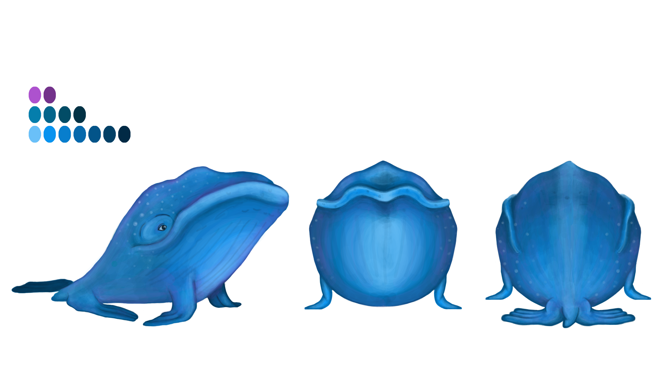
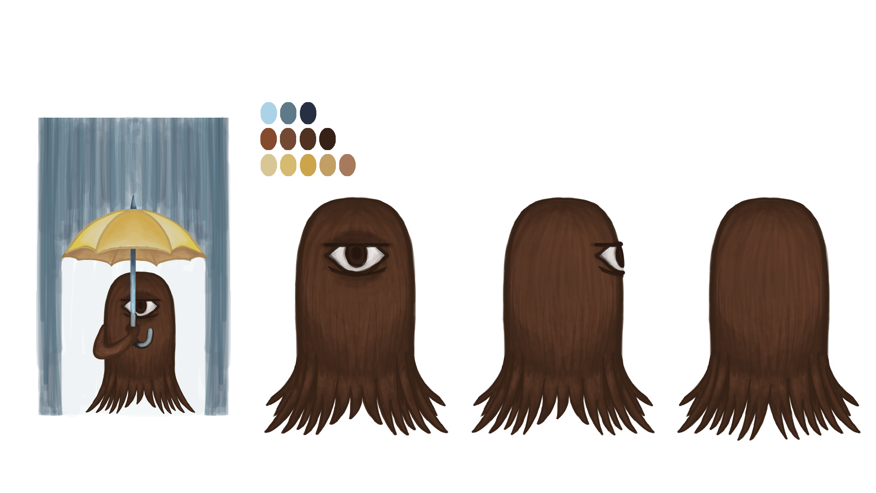
Character Design

Slide 8
Character Design

Slide 9
Character Design

Slide 10
Character Design

Slide 11
Character Design

Slide 12
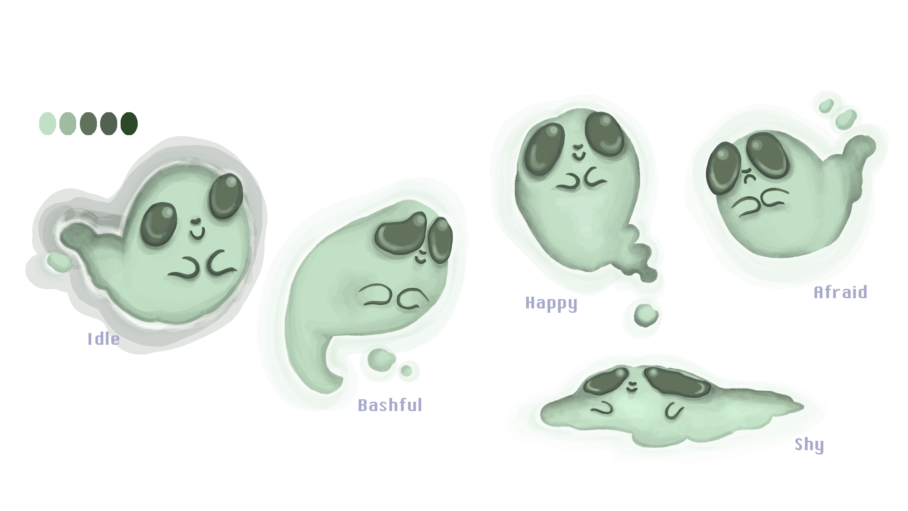
Character Design

Slide 13
Post-Mortem: What Went Well?
Concept
Worked out better than expected
Visual Design
Fantastical and appealing
The final aesthetics fits the concept well
Features
Feels like a great modern clicker game
Have a main objective in the game

Slide 14
Post-Mortem: Disasters
Visual Design Clash
Clashing aesthetics before settling on final designs
Behind on art assets
Concept
Main mechanic involved not playing the game
Main mechanic is the least engaging part of the game

Slide 15
Conclusion
Design is an iterative process
Constant iterations and changes results in extra work
No such thing as a perfect concept
Feature Bloat
Work out core features before planning more
Everyone visualize the visual design differently
Communication is very important between designers and artists

Slide 16
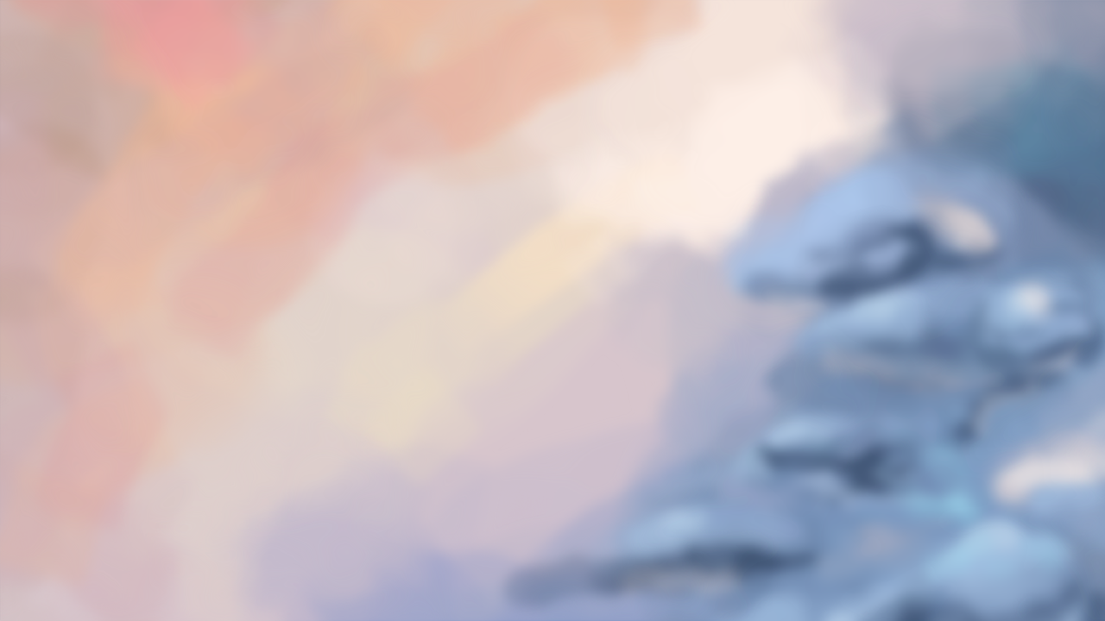
Thank You
Sleep well tonight

